Slide 1
Chapter 9 – Software QUALITY & QUALITY ASSURANCE
Anh Nguyen-Duc
Quan Thanh Tho
WEEK 9

Slide 2
Topics covered
Software Quality & its importance
Software testing types and techniques
Test plan and Test strategies

Slide 3
The importance of Software quality

Slide 4
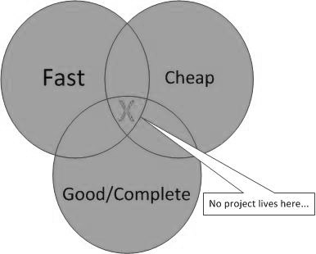
Why is Software quality important?
Notes:
In a software development project, Quality is one of the three pilar that build a project. Time Cost and Quality. Rule of thumbs is that we can only pick two of them.
But can not have three
Need for Speed
Accelerate (ITEA2): A Platform for the Acceleration of go-to market in the ICT industry
Continuous deployment, etc
In many circumstances, software quality was put in a low priority, for example, in startup companies that we are working a lot with, priority is to release as fast as possible and to amaze investors, rather than a really good product.

Slide 5
Definition of quality
(ISO) defines quality as the totality of characteristics of an entity that bear on its ability to satisfy stated or implied needs (ISO8042:1994) or the degree to which a set of inherent characteristics fulfils requirements. (ISO9000:2000).
Conformance to requirements means the project s processes and products meet written specifications.
Fitness for use means a product can be used as it was intended.
Quality aspects:
product: delivered to the customer
process: produces the software product
resources: (both the product and the process require resources)

Slide 6

Process quality vs. Product quality
Quality can mean the difference between excellence and disaster
Airbus A400M Atlas crash in 2015, 4 killed
Notes:
Quality can mean the difference between excellence and disaster
This is one of the recent incidence that was account for software issues. The airplan crashed on duty, every people died. The pilots reported that the plane had a technical fault and asked permission to land, but hit an electricity pylon while attempting an emergency landing.
The consequence is more severe as the aircraft model is banned in many countries. At that time Airbus only delivered 12 out of 174 units ordered so far. So image how much does it cost
150+ under delivery
Suspended from German, Malaysian, and Turkish air forces

Slide 7


Process quality vs. Product quality
“The black boxes attest to that there are no structural defects [with the aircraft], but we have a serious quality problem in the final assembly.”
“…either a weakness in the test procedure of planes before they fly, or a problem that results from the implementation of these procedures.”
Notes:
A thorough investigation on the airplane shows there is a quality issues in certain software components which was not found during the final integration.
Airbus CTO admit that it is a weakness in test procedure that causes the problem.

Slide 8

Product or process issue?
8/2016: Security breach with Bitcoin cost 72 mil. Usd lost in market
Notes:
Global bitcoin community in the second-biggest security breach ever of such an exchange
Nearly 120,000 units of bitcoin worth about US$72 million was stolen from the exchange platform Bitfinex in Hong Kong. In a sunny day and you suddenly find out your bitcoin account is little bit less. The consequence is amplied in exchange market. As you can see from the chart.
The coming day bitcoin lost about 18% its value. the theft had done his job in spreading confusion and frustration among market traders
The source of the vulnerability appears to lie in how Bitfinex structured its accounts and its use of bitcoin wallet provider

Slide 9
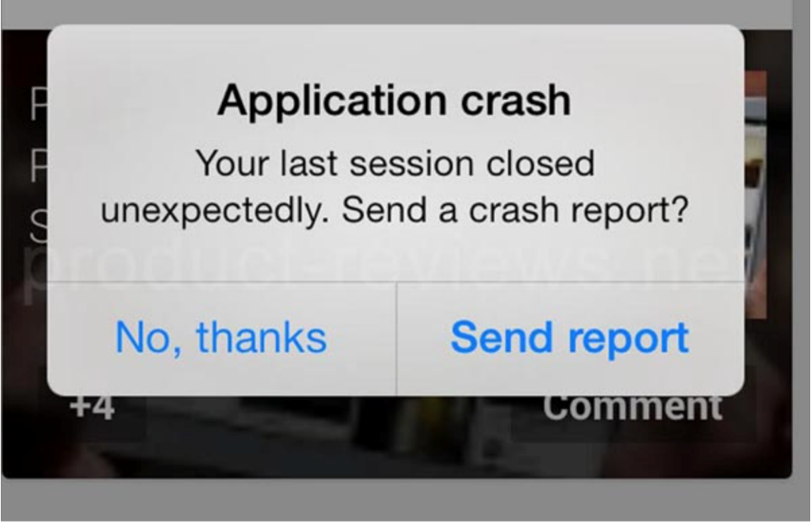
Software Quality attributes (1)
Notes:
We learn that there are different software quality attributes, just like different architectural views.
Reliability might be the most important attribute of quality. Your software is reliable means it is difficult to crash, it performs as its indented functions.
How difficult is the software to fail/ crash …?
The extent that software performes its intented functions?
Maintainability might be the most favor by developers. A maintainable software means it is easy to modify, to change, it is easy to locate and to fix a bug within its running environment. When we have to work with code from others, this is very important for our quality of life.
How easy to locate and to fix a bug within software operating environment?
Usability means how easy to use. This might be more abstract compare to others.
Is the software easy to use ?
Security is really mainstream topic today, as you see how serious it can be for a security flaw.
This is not every attributes.
How secure is the software?

Slide 10
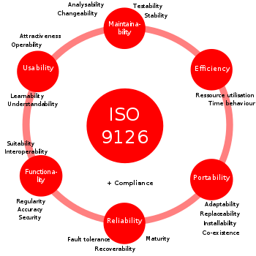
Software quality model

Slide 11
Software testing

Slide 12
Program testing
Testing is intended to show that a program does what it is intended to do and to discover program defects before it is put into use.
Can reveal the presence of errors NOT their absence.
Testing is part of a more general verification and validation process, which also includes static validation techniques.
Notes:
Testing is intended to show that a program does what it is intended to do and to discover program defects before it is put into use.
When you test software, you execute a program using artificial data.
You check the results of the test run for errors, anomalies or information about the program’s non-functional attributes.
Can reveal the presence of errors NOT their absence.
Testing is part of a more general verification and validation process, which also includes static validation techniques.

Slide 13
Program testing goals
To demonstrate to the developer and the customer that the software meets its requirements.
validation testing
To discover situations in which the behavior of the software is incorrect, undesirable or does not conform to its specification.
defect testing
Notes:
Testing goal
1. To demonstrate to the developer and the customer that the software meets its requirements. For custom software, this means that there should be at least one test for every requirement in the requirements document. For generic software products, it means that there should be tests for all of the system features, plus combinations of these features, that will be incorporated in the product release.
2. To discover situations in which the behavior of the software is incorrect, undesirable, or does not conform to its specification. These are a consequence of software defects. Defect testing is concerned with rooting out undesirable system behavior such as system crashes, unwanted interactions with other systems, incorrect computations, and data corruption.
The first goal leads to validation testing
To demonstrate to the developer and the system customer that the software meets its requirements
A successful validation test shows that the system operates as intended.
The second goal leads to defect testing
To discover faults or defects in the software where its behaviour is incorrect or not in conformance with its specification
A successful defect test is a test that makes the system perform incorrectly and so exposes a defect in the system.

Slide 14
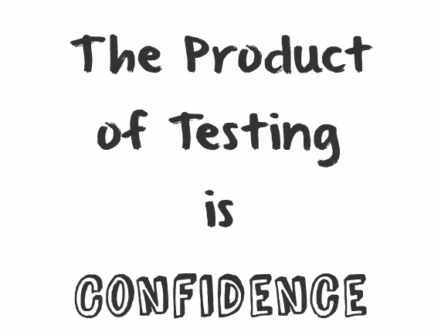
QUALITY ASSURANCE

Slide 15
Psychology of Testing (1)
A program is its programmer’s baby!
Trying to find errors in one’s own program is like trying to find defects in one’s own baby.
It is best to have someone other than the programmer doing the testing.
Tester must be highly skilled, experienced professional.
It helps if he or she possesses a diabolical mind.

Slide 16
Psychology of Testing (2)
Testing achievements depend a lot on what are the goals.
Myers says (79):
If your goal is to show absence of errors, you will not discover many.
If you are trying to show the program correct, your subconscious will manufacture safe test cases.
If your goal is to show presence of errors, you will discover large percentage of them.
Testing is the process of executing a program with the intention of finding errors (G. Myers)

Slide 17
An input-output model of program testing
Notes:
Think of the system being tested as a black box. The system accepts inputs from some input set I and generates outputs in an output set O.
Some of the outputs will be erroneous. These are the outputs in set Oe that are generated by the system in response to inputs in the set Ie.
The priority in defect testing is to find those inputs in the set Ie because these reveal problems with the system.
Validation testing involves testing with correct inputs that are outside Ie.
These stimulate the system to generate the expected correct outputs.

Slide 18
A model of the software testing process
Notes:
An abstract model of the ‘traditional’ testing process
Test cases = the inputs to the test + the expected output (the test results) + a statement of what is being tested.
Test data = the inputs that have been devised to test a system.
Test data can sometimes be generated automatically
(automatic test case generation is impossible, as people who understand what the system is supposed to do must be involved to specify the expected test results.)
Test execution can be automated:
The expected results are automatically compared with the predicted results so there is no need for a person to look for errors and anomalies in the test run.

Slide 19
Stages of testing
Development testing
the system is tested during development to discover bugs and defects.
Release testing
a separate testing team test a complete version of the system before it is released to users.
User testing
users or potential users of a system test the system in their own environment.
Notes:
Software system has to go through three stages of testing:
1. Development testing, where the system is tested during development to discover bugs and defects. System designers and programmers are likely to be involved in the testing process.
2. Release testing, where a separate testing team tests a complete version of the system before it is released to users. The aim of release testing is to check that the system meets the requirements of system stakeholders.
3. User testing, where users or potential users of a system test the system in their own environment. For software products, the ‘user’ may be an internal marketing group who decide if the software can be marketed, released, and sold.
Acceptance testing is one type of user testing where the customer formally tests a system to decide if it should be accepted from the system supplier or if further
development is required.

Slide 20
Development testing
carried out by the team developing the system.
Unit testing:
for individual program units or object classes
focus on testing the functionality of objects or methods.
Component testing:
several individual units are integrated to create composite components
focus on testing component interfaces.
System testing:
some or all of the components in a system are integrated and the system is tested as a whole
focus on testing component interactions.
Notes:
Development testing includes all testing activities that are carried out by the team developing the system.
Unit testing, where individual program units or object classes are tested. Unit testing should focus on testing the functionality of objects or methods.
Component testing, where several individual units are integrated to create composite components. Component testing should focus on testing component interfaces.
System testing, where some or all of the components in a system are integrated and the system is tested as a whole. System testing should focus on testing component interactions.

Slide 21
Unit testing
Unit testing is the process of testing individual components in isolation.
It is a defect testing process.
Units may be:
Individual functions or methods within an object
Object classes with several attributes and methods
Composite components with defined interfaces used to access their functionality.

Slide 22
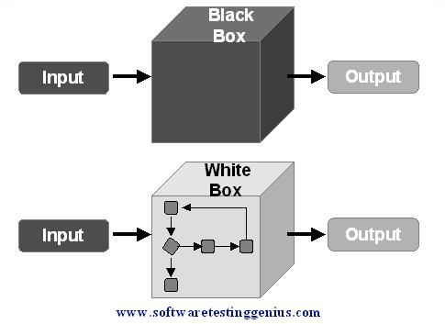
Unit Testing: Black-/White-box Test
from requirements
Compare actual output with require output
from requirements & key design elements
Confirm expected behaviour
Gray-box: mix of black- and white-box testing
Notes:
Black-box testing:
Input: from requirements (input data)
Output: prepare required output
Check: compare actual output with required output
White-box testing:
Input: Key design elements
Output: behaviour
Check: confirm the expected behavior
Grey-box testing:
Black-box + White-box testing

Slide 23
for (i=0; i<numrows; i++)
for (j=0; j<numcols; j++);
pixels++;
int minval(int *A, int n) {
int currmin;
for (int i=0; i<n; i++)
if (A[i] < currmin)
currmin = A[i];
return currmin;
}
Notes:
Example 1: Caused by a stray ";" on line 2. Accidental bugs are often caused by stray characters, etc. While "minor" in their fix, they can be the devil to find!
Example 2: Since currmin was never initialized, it could easily start out as the minimum value. Some compilers spot no-initialization errors. Note that an improper initialization, while rarer, is even harder to spot than a missing one!

Slide 24
switch (i) {
case 1:
do_something(1); break;
case 2:
do_something(2); break;
case 3:
do_something(1); break;
case 4:
do_something(4); break;
default:
break;
}
Notes:
Example 3: The cases were generated by copying case 1. Under case 3, the values were not changed as appropriate for the case. Code reuse is good -- but this form of code copying has its dangers!

Slide 25
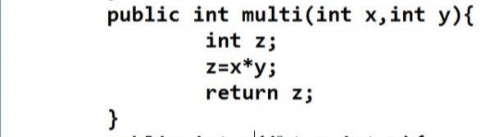
Equivalence partitioning & Boundary value analysis

Slide 26
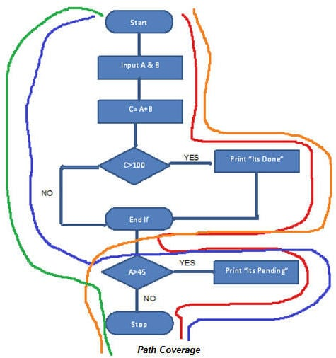
White-box testing
Statement coverage
Branch coverage
Path coverage
Notes:
https://www.youtube.com/watch?v=h_YnXgKG65U

Slide 27
Regression testing
Test the system to check that changes have not ‘broken’ previously working code.
Better with automated testing
All tests are re-run every time a change is made to the program.
Tests must run ‘successfully’ before the change is committed.
Notes:
Regression testing is testing the system to check that changes have not ‘broken’ previously working code.
In a manual testing process, regression testing is expensive but, with automated testing, it is simple and straightforward. All tests are rerun every time a change is made to the program.
Tests must run ‘successfully’ before the change is committed.

Slide 28
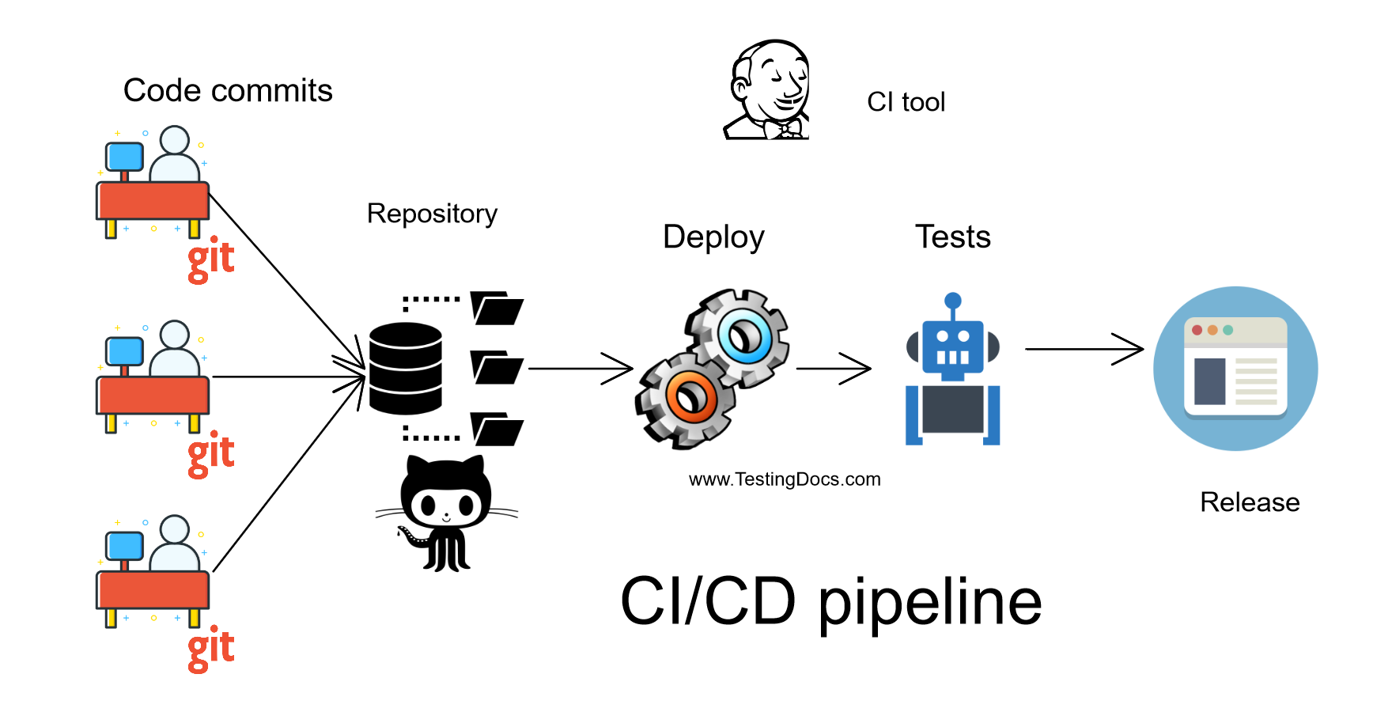
Automated testing
Whenever possible, unit testing should be automated
Use of a test automation framework (such as JUnit)
Notes:
Whenever possible, unit testing should be automated so that tests are run and checked without manual intervention.
In automated unit testing, you make use of a test automation framework (such as JUnit) to write and run your program tests.
Unit testing frameworks provide generic test classes that you extend to create specific test cases. They can then run all of the tests that you have implemented and report, often through some GUI, on the success of otherwise of the tests.
Automated test components
A setup part, where you initialize the system with the test case, namely the inputs and expected outputs.
A call part, where you call the object or method to be tested.
An assertion part where you compare the result of the call with the expected result. If the assertion evaluates to true, the test has been successful if false, then it has failed.

Slide 29
System testing
System testing during development = to create a version of the system and then testing the integrated system.
Focus on testing the interactions between components.
System testing checks that components are compatible, interact correctly and transfer the right data at the right time across their interfaces.
And tests the emergent behaviour of a system.
Notes:
System testing during development involves integrating components to create a version of the system and then testing the integrated system.
The focus in system testing is testing the interactions between components.
System testing checks that components are compatible, interact correctly and transfer the right data at the right time across their interfaces.
System testing tests the emergent behaviour of a system.
System and component testing
During system testing, reusable components that have been separately developed and off-the-shelf systems may be integrated with newly developed components. The complete system is then tested.
Components developed by different team members or sub-teams may be integrated at this stage. System testing is a collective rather than an individual process.
In some companies, system testing may involve a separate testing team with no involvement from designers and programmers.

Slide 30
Functionality Tests
Robustness Tests
Interoperability Tests
Performance Tests
Scalability Tests
Stress Tests
Load and Stability Tests
Regression Tests
Regulatory Tests
Safety Assurance
Acceptance Testing
GUI Testing
Security Testing
Tests are designed to verify each of the functionalities
Tests are designed to verify that all the modules function individually as desired within the systems
The idea here is to ensure that individual modules function correctly within the whole system.

Slide 31
Tests are designed to verify
different components such as icons, menu bars, dialog boxes, scroll bars, list boxes, and radio buttons
The GUI can be utilized to test the functionality behind the interface, such as:
The usability characteristics of the GUI is tested, which includes the following
Accessibility: Can users enter, navigate, and exit with relative ease?
Responsiveness: Can users do what they want and when they want in a way that is clear?
Efficiency: Can users do what they want to with minimum number of steps and time?
Comprehensibility: Do users understand the product structure with a minimum amount of effort?
look-and-feel the interface to the users of an application system
accurate response to database queries
usefulness of the on-line help, error messages, tutorials, and user manuals
Functionality Tests
Robustness Tests
Interoperability Tests
Performance Tests
Scalability Tests
Stress Tests
Load and Stability Tests
Regression Tests
Regulatory Tests
Safety Assurance
Acceptance Testing
GUI Testing
Security Testing

Slide 32
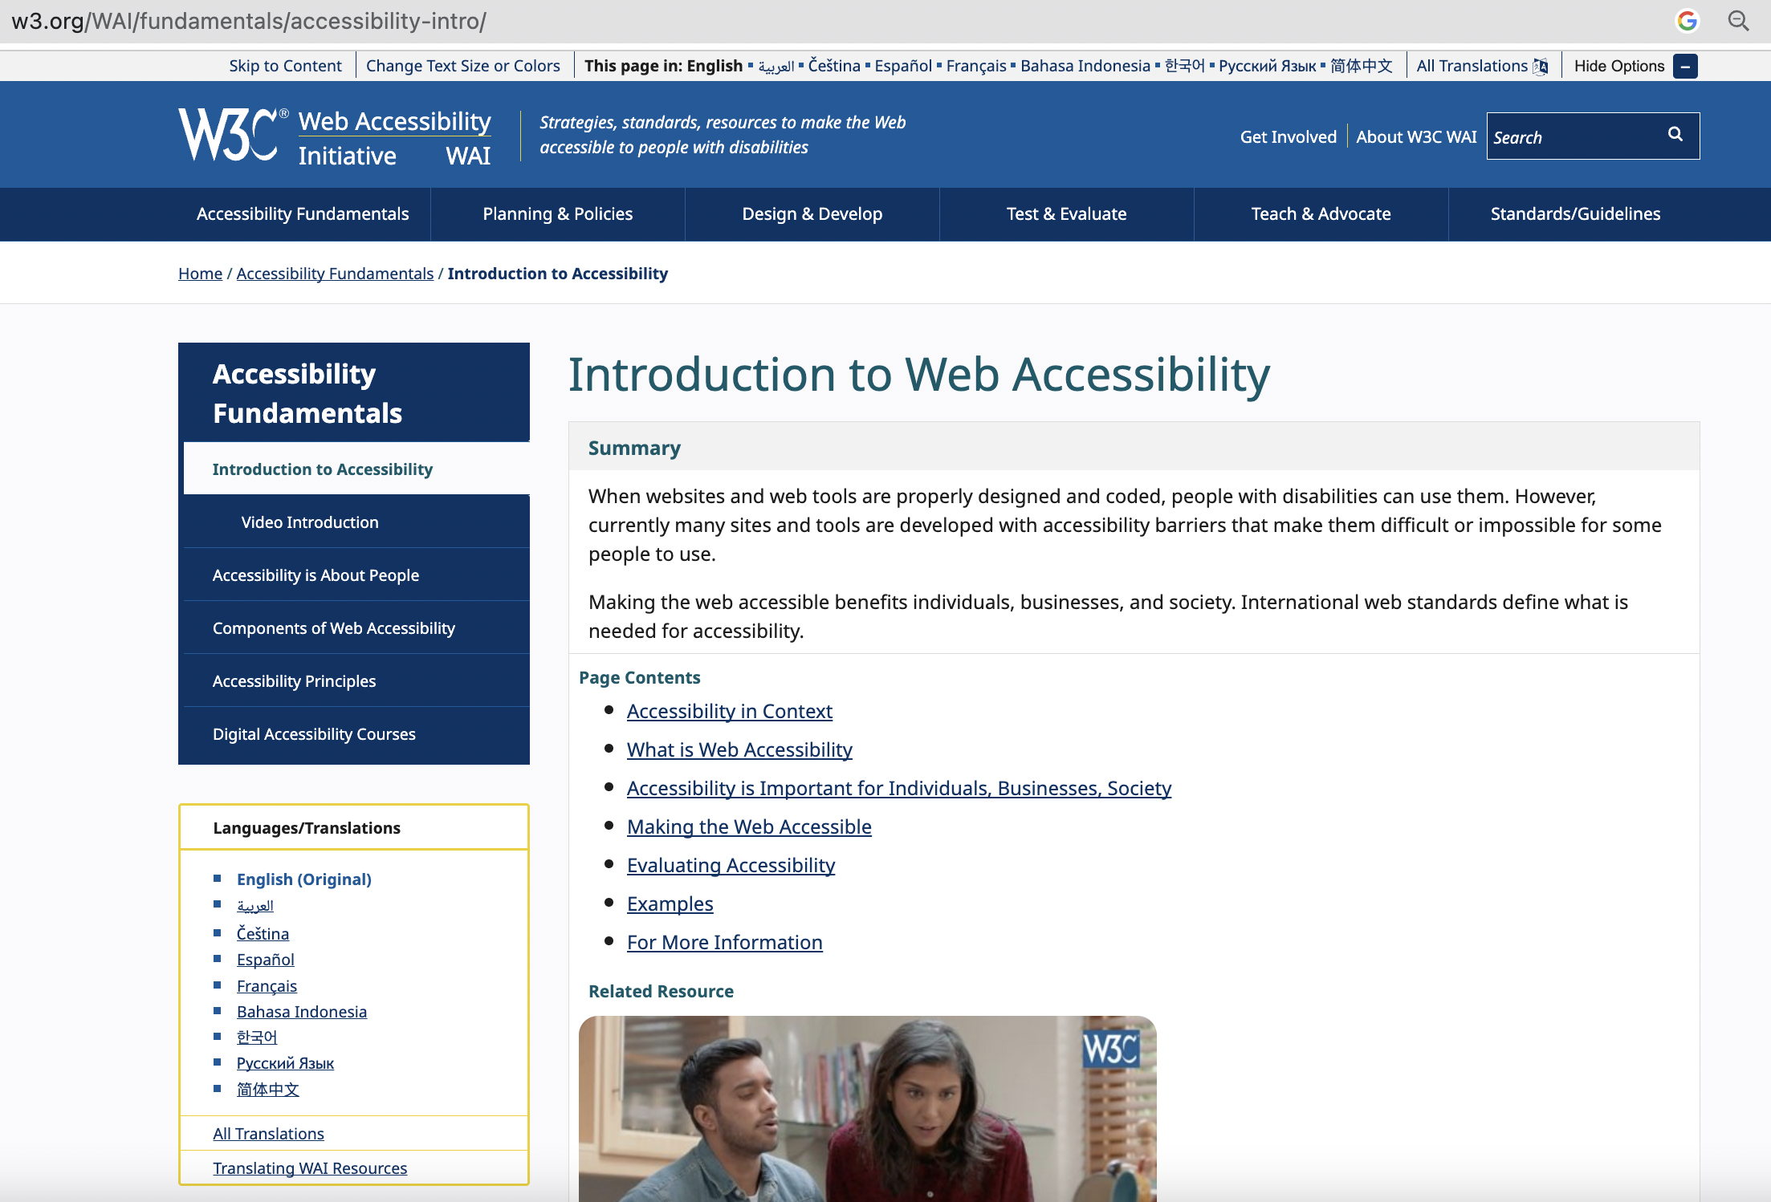
Functionality Tests
Robustness Tests
Interoperability Tests
Performance Tests
Scalability Tests
Stress Tests
Load and Stability Tests
Regression Tests
Regulatory Tests
Safety Assurance
Acceptance Testing
GUI Testing
Security Testing
https://www.w3.org/WAI/policies/norway/

Slide 33
Functionality Tests
Robustness Tests
Interoperability Tests
Performance Tests
Scalability Tests
Stress Tests
Load and Stability Tests
Regression Tests
Regulatory Tests
Safety Assurance
Acceptance Testing
GUI Testing
Security Testing
Tests are designed to verify the ability of the system to inter-operate with third party products.
Compatibility tests are tests that verify that the system works the same way across different platforms, operating systems, data base management systems
Backward compatibility tests verify that the current software build flawlessly works with older version of platforms

Slide 34
Functionality Tests
Robustness Tests
Interoperability Tests
Performance Tests
Scalability Tests
Stress Tests
Load and Stability Tests
Regression Tests
Regulatory Tests
Safety Assurance
Acceptance Testing
GUI Testing
Security Testing
Robustness means how much sensitive a system is to erroneous input and changes its operational environment
Tests in this category are designed to verify how gracefully the system behaves in error situations and in a changed operational environment
The tests include providing invalid input data to the system and observing how the system reacts to the invalid input.
Power cycling tests are executed to ensure that, when there is a power glitch in a deployment environment, the system can recover from the glitch to be back in normal operation after power is restored.
Availability tests are designed to is to verify that the system gracefully and quickly recovers from hardware and software failures without adversely impacting the operation of the system.
Some types of robustness tests:

Slide 35
Functionality Tests
Robustness Tests
Interoperability Tests
Performance Tests
Scalability Tests
Stress Tests
Load and Stability Tests
Regression Tests
Regulatory Tests
Safety Assurance
Acceptance Testing
GUI Testing
Security Testing
Tests are designed to determine the performance of the actual system compared to the expected one
For Example: If the objective is to evaluate the response time, then one needs to capture
End-to-end response time (as seen by external user)
CPU time
Network connection time
Database access time
Network connection time
Waiting time
Examples of Performance metrics: response time, execution time, throughput, resource utilization and traffic rate

Slide 36
Tests are designed to verify that the system can scale up to its engineering limits while continuing to meet performance requirements
Scaling tests are conducted to ensure that the system response time remains the same, or increases by a small amount, as the number of users are increased.
There are three major causes of these limitations:
data storage limitations
network bandwidth limitations
speed limit
Functionality Tests
Robustness Tests
Interoperability Tests
Performance Tests
Scalability Tests
Stress Tests
Load and Stability Tests
Regression Tests
Regulatory Tests
Safety Assurance
Acceptance Testing
GUI Testing
Security Testing

Slide 37
Functionality Tests
Robustness Tests
Interoperability Tests
Performance Tests
Scalability Tests
Stress Tests
Load and Stability Tests
Regression Tests
Regulatory Tests
Safety Assurance
Acceptance Testing
GUI Testing
Security Testing
The system is deliberately stressed by pushing it to and beyond its specified limits
It ensures that the system can perform acceptably under worst-case conditions, under an expected peak load.
Targeted to bring out the problems associated with: Memory leak and Buffer allocation and memory carving
Notes:
Snapshots of computers' volatile memory (i.e. RAM) can be carved. Memory-dump carving is routinely used in digital forensics, allowing investigators to access ephemeral evidence. Ephemeral evidence includes recently accessed images and Web pages, documents, chats and communications committed via social networks. If an encrypted volume (TrueCrypt, BitLocker, PGP Disk) was used, binary keys to encrypted containers can be extracted and used to instantly mount such volumes. The content of volatile memory gets fragmented. A proprietary carving algorithm was developed by Belkasoft to enable carving fragmented memory sets (BelkaCarving).

Slide 38
Functionality Tests
Robustness Tests
Interoperability Tests
Performance Tests
Scalability Tests
Stress Tests
Load and Stability Tests
Regression Tests
Regulatory Tests
Safety Assurance
Acceptance Testing
GUI Testing
Security Testing
When a large number of users are introduced a number of problems are likely to occur:
the system slows down
the system encounters functionality problems
the system crashes altogether
Load and stability testing typically involves exercising the system with virtual users and measuring the performance to verify whether the system can support the anticipated load

Slide 39
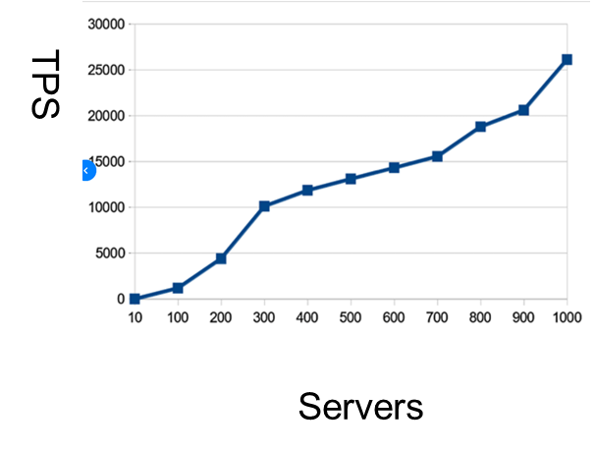
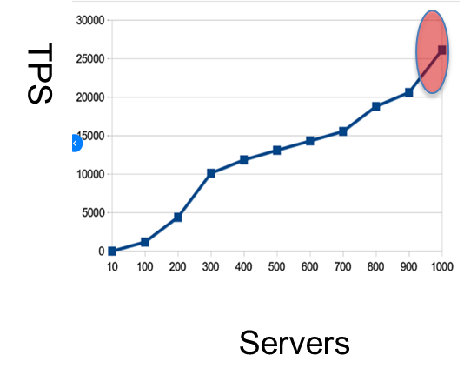
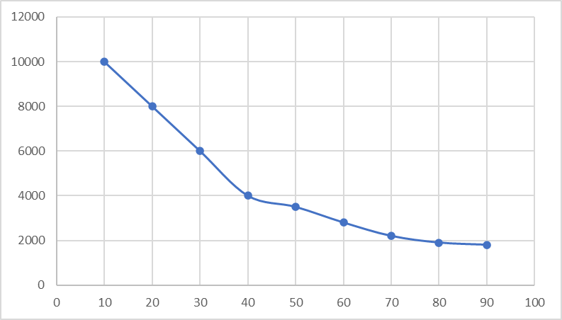
TPS(Transaction per second)
Functionality Tests
Robustness Tests
Interoperability Tests
Performance Tests
Scalability Tests
Stress Tests
Load and Stability Tests
Regression Tests
Regulatory Tests
Safety Assurance
Acceptance Testing
GUI Testing
Security Testing
Scalability
Stress
Load and stability
TPS
Time

Slide 40
Functionality Tests
Robustness Tests
Interoperability Tests
Performance Tests
Scalability Tests
Stress Tests
Load and Stability Tests
Regression Tests
Regulatory Tests
Safety Assurance
Acceptance Testing
GUI Testing
Security Testing
Testing of security requirements that concerns confidentiality, integrity, availability, authentication, authorization, nonrepudiation, and;
The testing to validate the ability of the software to withstand attack (resiliency).

Slide 41

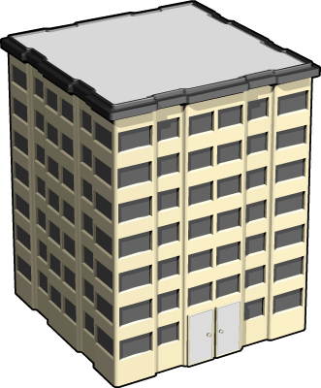

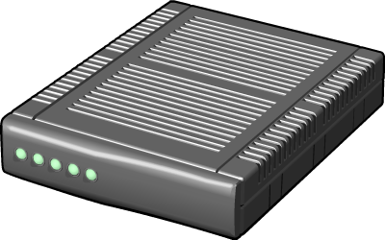
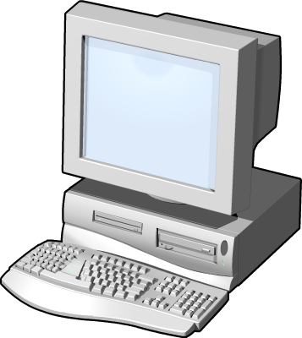



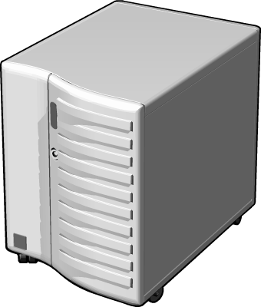






Functionality Tests
Robustness Tests
Interoperability Tests
Performance Tests
Scalability Tests
Stress Tests
Load and Stability Tests
Regression Tests
Regulatory Tests
Safety Assurance
Acceptance Testing
GUI Testing
Security Testing
Organizational
Attacks
Hackers
Automated
Attacks
Restricted Data
DoS
Accidental
Breaches
in Security
Connection Fails
Denial of
Service (DoS)
Viruses, Trojan Horses, and Worms

Slide 42
Functionality Tests
Robustness Tests
Interoperability Tests
Performance Tests
Scalability Tests
Stress Tests
Load and Stability Tests
Regression Tests
Regulatory Tests
Safety Assurance
Acceptance Testing
GUI Testing
Security Testing
Network
Host
Application
Threats against
the network
Spoofed packets, etc.
Buffer overflows, illicit paths, etc.
Threats against the host
SQL injection, XSS, input tampering, etc.
Threats against the application

Slide 43
Authentication and password management
Key and Secrets Management
Data, Hardware, Personell, Software Integrity
Availability Protection
Audit logging and analysis
Physical and Vehicle Security
Network
Security
Privacy
Attack Detection
Authorization and role management
Session Management
Non-Repudiation
Functionality Tests
Robustness Tests
Interoperability Tests
Performance Tests
Scalability Tests
Stress Tests
Load and Stability Tests
Regression Tests
Regulatory Tests
Safety Assurance
Acceptance Testing
GUI Testing
Security Testing

Slide 44
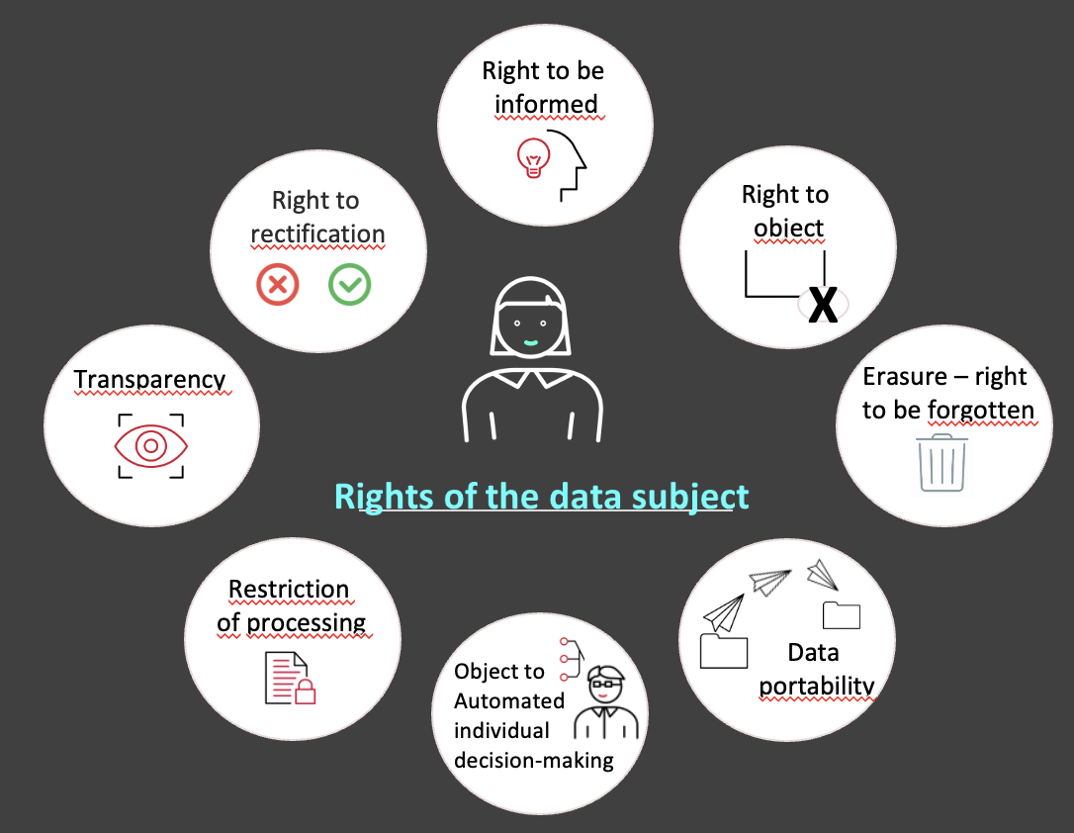
Privacy and GDPR
Functionality Tests
Robustness Tests
Interoperability Tests
Performance Tests
Scalability Tests
Stress Tests
Load and Stability Tests
Regression Tests
Regulatory Tests
Safety Assurance
Acceptance Testing
GUI Testing
Security Testing

Slide 45
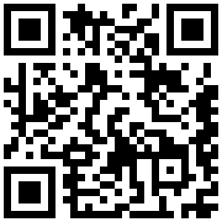
Privacy and GDPR
Functionality Tests
Robustness Tests
Interoperability Tests
Performance Tests
Scalability Tests
Stress Tests
Load and Stability Tests
Regression Tests
Regulatory Tests
Safety Assurance
Acceptance Testing
GUI Testing
Security Testing
https://gdpr.eu/tag/gdpr/

Slide 46
Functionality Tests
Robustness Tests
Interoperability Tests
Performance Tests
Scalability Tests
Stress Tests
Load and Stability Tests
Regression Tests
Regulatory Tests
Safety Assurance
Acceptance Testing
GUI Testing
Security Testing
The final system is shipped to the regulatory bodies in those countries where the product is expected to be marketed
The regulatory agencies are usually interested in identifying flaws in software that have potential safety consequences
The safety requirements are primarily based on their own published standards

Slide 47
Functionality Tests
Robustness Tests
Interoperability Tests
Performance Tests
Scalability Tests
Stress Tests
Load and Stability Tests
Regression Tests
Regulatory Tests
Safety Assurance
Acceptance Testing
GUI Testing
Security Testing
Software safety is defined in terms of hazards
A software in isolation cannot do physical damage. However, a software in the context of a system and an embedding environment could be vulnerable
There are two basic tasks performed by a safety assurance engineering team:
Provide methods for identifying, tracking, evaluating, and eliminating hazards associated with a system
Ensure that safety is embedded into the design and implementation in a timely and cost effective manner, such that the risk created by the user/operator error is minimized
A hazard is a state of a system or a physical situation which when combined with certain environmental conditions, could lead to an accident that results in death, injury, illness, damage or loss of property, or harm to the environment.

Slide 48
Functionality Tests
Robustness Tests
Interoperability Tests
Performance Tests
Scalability Tests
Stress Tests
Load and Stability Tests
Regression Tests
Regulatory Tests
Safety Assurance
Acceptance Testing
GUI Testing
Security Testing
P
P’
P’’
Add
Delete
Modify
Add
Delete
Modify
Add
Delete
Modify
…
First test
Regression test
Regression test
One of the main goals is to verify that no defect has been introduced into the unchanged portion of a system due to changes made elsewhere in the system with maximized likelihood of uncovering new defects and reduced cost of testing

Slide 49
Test revalidation
(Regression) test selection
Verify changed and impacted code (corrective)
Verify new structure and requirements (progressive)
Test minimization
Remove redundant test cases
Test prioritization
Rank test cases and run them according to available resources
Unchanged code continues to behave correctly
Are test cases obsolete?
Do not remove test cases from the set
Functionality Tests
Robustness Tests
Interoperability Tests
Performance Tests
Scalability Tests
Stress Tests
Load and Stability Tests
Regression Tests
Regulatory Tests
Safety Assurance
Acceptance Testing
GUI Testing
Security Testing
Notes:
How can a test case be obsolete?
Their input/output relation is no longer correct due to changes in specification
They no longer test what they were designed to test due to modifications to the program
They are “structural” test cases that no longer contribute to structural coverage of the program
Unlike test prioritization of the first test
More information available
Fault finding effectiveness
Test coverage
Cost of running the test
Prioritization strategies ^{[5]}
Coverage based (high coverage)
Cost-aware based (low cost to run, high fault-finding probability)
…

Slide 50
Functionality Tests
Robustness Tests
Interoperability Tests
Performance Tests
Scalability Tests
Stress Tests
Load and Stability Tests
Regression Tests
Regulatory Tests
Safety Assurance
Acceptance Testing
GUI Testing
Security Testing
Retest all
Can be costly, unless test execution is highly automated
Random selection
Better than no test
Hard to ensure coverage of the changed code
Selecting modification traversing tests
A technique that does not discard any test that will traverse a modified or impacted statement is known as “safe” regression test selection technique
Notes:
Progressive: Testing involves changes of specification in P, meaning P’, P’’ should be test against S’, S’’ respectively
Verify
Newly added or modified code behaves correctly
Unchanged code continues to behave correctly
Testing involves no changes of specification
Verify
Modified code behaves correctly
Unchanged code continues to behave correctly

Slide 51
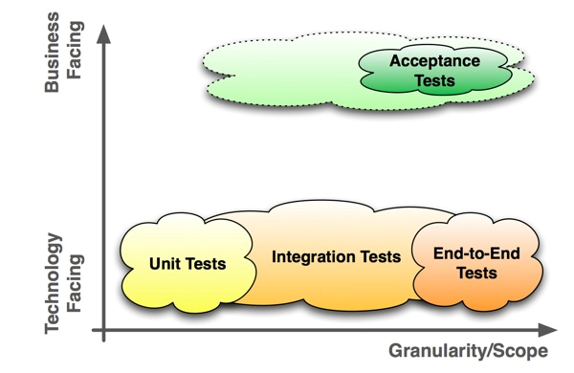
Three major objectives of acceptance testing:
Confirm that the system meets the agreed upon acceptance criteria
Identify and resolve discrepancies, if there is any
Determine the readiness of the system for cut-over to live operations
Functionality Tests
Robustness Tests
Interoperability Tests
Performance Tests
Scalability Tests
Stress Tests
Load and Stability Tests
Regression Tests
Regulatory Tests
Safety Assurance
Acceptance Testing
GUI Testing
Security Testing
Notes:
User Acceptance Testing (UAT)
It is conducted by the customer to ensure that system satisfies the contractual acceptance criteria before being signed-off as meeting user needs.
Business Acceptance Testing (BAT)
It is undertaken within the development organization of the supplier to ensure that the system will eventually pass the user acceptance testing.

Slide 52
Test planning

Slide 53
Use-case testing – Test case
Test case | SUC3 Correct PIN entry on first try
Test description | A customer enters the PIN number correctly on the first attempt.
Related screens
Pre-conditions | The expected PIN is known Screen 2 is displayed
Actions | 1. Screen 2 shows ‘- - - - ’ 2. Customer touches 1st digit 3. Screen 2 shows ‘- - - * ’ 4. Customer touches 2nd digit 5. Screen 2 shows ‘- - * * ’ 6. Customer touches 3rd digit 7. Screen 2 shows ‘- * * * ’ 8. Customer touches 4th digit 9. Screen 2 shows ‘* * * * ’ 10. Customer touches Enter 11. Screen 5 is displayed
Inputs | Correct PIN number: 1357
Expected Outputs | Select Transaction screen is active
Testing environment | Software interface run in Windows 10
Notes:
The use-cases developed to identify system interactions can be used as a basis for system testing.
Each use case usually involves several system components so testing the use case forces these interactions to occur.
The sequence diagrams associated with the use case documents the components and interactions that are being tested.

Slide 54
Use-case testing
The use-cases developed to identify system interactions can be used as a basis for system testing.
Each use case usually involves several system components so testing the use case forces these interactions to occur.
The sequence diagrams associated with the use case documents the components and interactions that are being tested.
Notes:
The use-cases developed to identify system interactions can be used as a basis for system testing.
Each use case usually involves several system components so testing the use case forces these interactions to occur.
The sequence diagrams associated with the use case documents the components and interactions that are being tested.

Slide 55
TEST PLAN
Testing requires meticulous planning on an operational level and on a strategic level
The test manager needs to transpose such generic guidelines to create a concrete testing strategy for the project at hand
Test plan should state:
Test object: which components, modules, neighboring systems, and interfaces (will) make up the system to be tested
test objectives: specific testing objectives and the criteria you are testing against for each test object and the entire system
Customize the testing process
testing methods and techniques: overall testing approach and the testing techniques
required infrastructure
Success/ failure criteria: test metrics and threshold

Slide 56
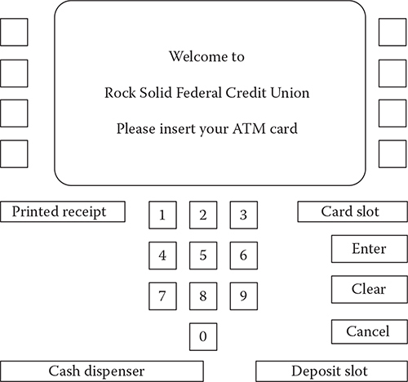
A case – ATM TERMINAL SOFTWARE TESTING
A simple version of ATM machine
Insert your card, type PIN code and withdraw cash from the machine

Slide 57
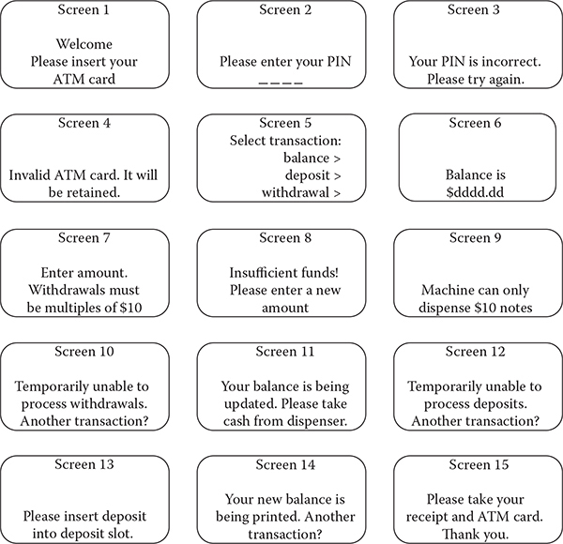
A case – ATM TERMINAL SOFTWARE TESTING
List of designed screens

Slide 58
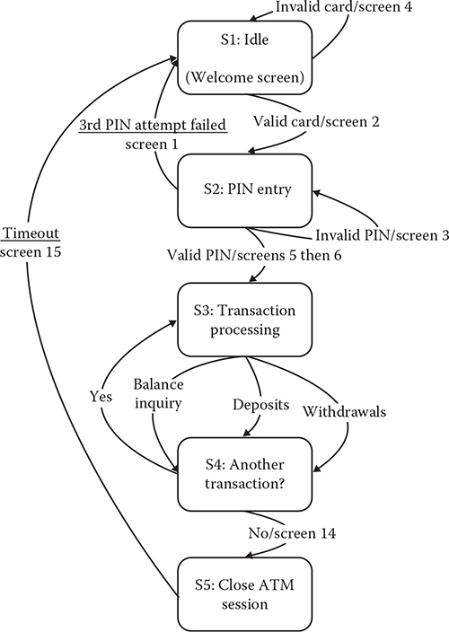
A case – ATM TERMINAL SOFTWARE TESTING
State diagram from the Idle state to the Closed ATM session

Slide 59
Test plan - example
Type of tests | Description | Number of tests | Test types | Test data | Test metric
Unit test | Testing each screen to make sure each screen displays according to its specification | At least 15 assertation: S1 – S15 | Whitebox blackbox | Pin code, Amount to withdraw | Path coverage Line coverage Branch coverage
System test/ Use case test | Testing possible different use case scenarios with successful and unsuccessful ATM transactions | At least 25 test cases as below | Blackbox | Pin code, Amount to withdraw | Requirement coverage
Usability test | Evaluate the user experience with the ATM interfaces with the two scenarios with successful and unsuccessful ATM transactions | At least 2 test cases | Blackbox | Tasks to perform Pin code, Amount to withdraw | Usability score
Performance test | Simulating POS system’s transaction processing under extreme conditions Internet-based transactions | 1 test with 100 transactions and another test with 1000 transactions | Blackbox | Number of transactions Amount to withdraw | Transaction time Delayed time

Slide 60
USER ACCEPTANCE TEST (UAT)
acceptance testing is a test conducted to determine if the requirements of a specification or contract are met
It can look like a system test … with customer involvement
It is blackbox testing
It may involve performance test, stress test, usability test, etc
Testers should be given real-life scenarios such as the three most common or difficult tasks that the users they represent will undertake

Slide 61
Stages in the acceptance testing process
Define acceptance criteria
Plan acceptance testing
Derive acceptance tests
Run acceptance tests
Negotiate test results
Reject/accept system

Slide 62
exercise
Use Case: Logging into a Social Media Application
Description: The user needs to log into a social media application in order to access their account and interact with other users.
Actor: User
Precondition: The user has already installed the social media application on their device.
Basic Flow:
The user opens the social media application.
The application presents the login screen.
The user enters their username and password and clicks on the "Log In" button.
The application verifies the user's credentials and logs them into their account.
The application presents the user's home screen with their newsfeed and other options.
Alternate Flows:
If the user enters an incorrect username or password, the application displays an error message and prompts the user to re-enter their credentials.
If the user forgets their password, they can click on the "Forgot Password" link and enter their email address to receive a password reset link.
If the user does not have an account, they can click on the "Sign Up" button to create a new account.
Postcondition: The user is logged into their social media account and can access their newsfeed and interact with other users.

Slide 63
exercise
Use the Test plan table in Slide 59 to plan for testing this use case
Come up with at least 10 test cases for functional testing, performance testing, security testing, usability testing and compatibility testing
Notes:
Positive Test Case - Successful Login Inputs: Valid username and password Expected Output: User is successfully logged into their account and presented with their home screen.
Negative Test Case - Invalid Username Inputs: Invalid username and valid password Expected Output: Error message is displayed and user is prompted to enter a valid username.
Negative Test Case - Invalid Password Inputs: Valid username and invalid password Expected Output: Error message is displayed and user is prompted to enter a valid password.
Negative Test Case - Invalid Username and Password Inputs: Invalid username and invalid password Expected Output: Error message is displayed and user is prompted to enter valid credentials.
Alternate Flow Test Case - Forgot Password Inputs: Click on "Forgot Password" link and enter a valid email address Expected Output: Password reset link is sent to the email address and user is prompted to reset their password.
Alternate Flow Test Case - New User Registration Inputs: Click on "Sign Up" button and enter valid registration details Expected Output: New user account is created and user is logged into their account.
Negative Test Case - User Account Locked Out Inputs: Enter invalid credentials multiple times until account is locked out Expected Output: Error message is displayed and user is notified that their account has been locked. User must reset their password to regain access.
Non-functional Test Case - Performance Inputs: Attempt to log into the application with a large number of concurrent users Expected Output: The application should handle the load and not crash or slow down significantly.
Non-functional Test Case - Security Inputs: Attempt to log into the application with invalid or malicious credentials Expected Output: The application should block the attempt and not allow unauthorized access to user accounts.
Non-functional Test Case - Compatibility Inputs: Test the application on different platforms and devices, such as iOS, Android, and web browsers. Expected Output: The application should work correctly and consistently on all supported platforms and devices.

